Slide 1


Slide 2
Chapter 1
The Selection of a Research Approach

Slide 3
Introduction
Research approaches – plans and the procedures for research that span the steps
Research designs – procedures for inquiry
Research methods – specific data collection, analysis, and interpretation methods
Research problem – issue being addressed
Notes:
The book uses three key terms throughout: Research approaches, research designs, and research methods. They represent the perspective about research from broad constructions of research to the narrow procedures of methods.

Slide 4
The Three Approaches to Research
Qualitative
Quantitative
Mixed methods

Slide 5
The Three Approaches to Research
Qualitative research:
Focuses on understanding meaning
Uses emerging questions
Collects data in participant’s setting
Uses the an inductive approach to analysis
Has a written report that is flexible in structure

Slide 6
The Three Approaches to Research
Quantitative research:
Tests objective theories
Examines relationships among measurable variables
Uses survey instruments that produce numbered data
Uses statistical analysis of data generated
Tests theories deductively
Uses a set structure for the final report

Slide 7
The Three Approaches to Research
Mixed methods research:
Collects both quantitative and qualitative data
Integrates the two forms of data
Uses distinct designs that may involve philosophy or theory
Yields additional insight to a research problem

Slide 8
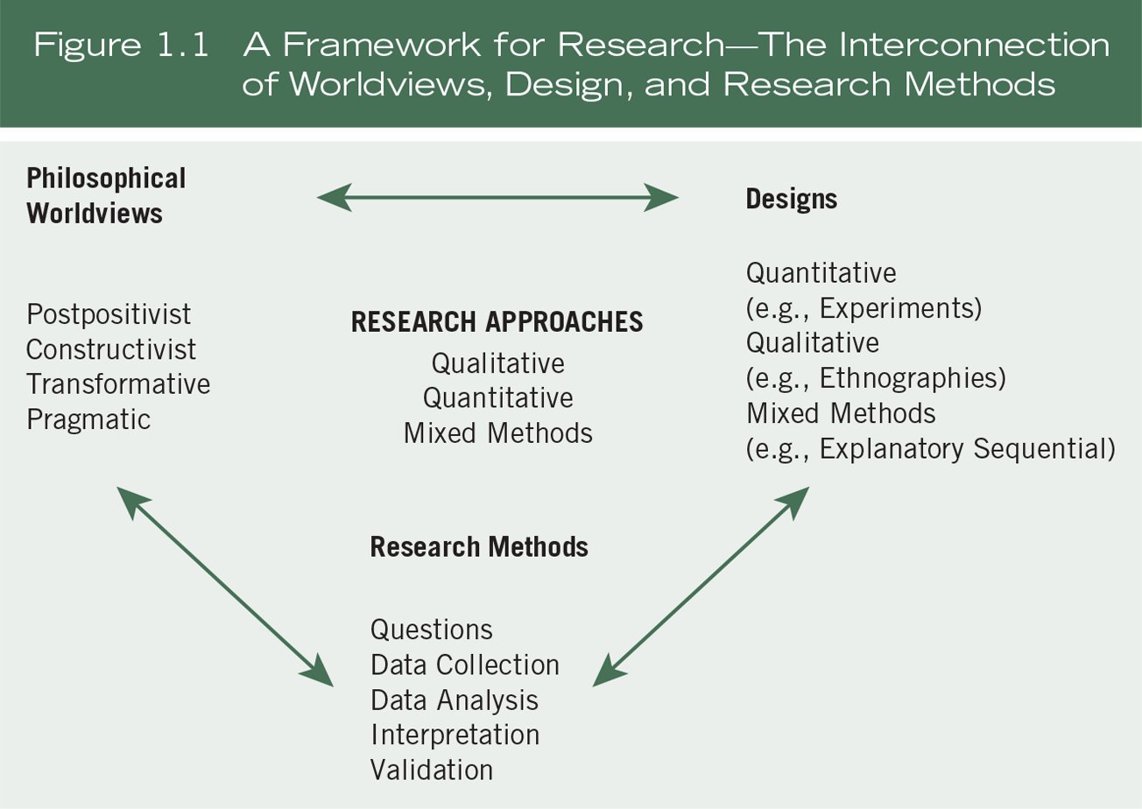
Three Components Involved in an Approach

Slide 9
Three Components Involved in an Approach
Philosophical worldviews:
Beliefs about the world and nature of research
Make explicit in proposal
Four common worldviews:
  Postpositivism
  Constructivism
  Transformative
  Pragmatism

Slide 10

Three Components Involved in an Approach

Slide 11
Three Components Involved in an Approach
Research designs:
Types of inquiry
Qualitative, quantitative, or mixed methods
Provides specific direction for procedures
Types of designs have grown

Slide 12
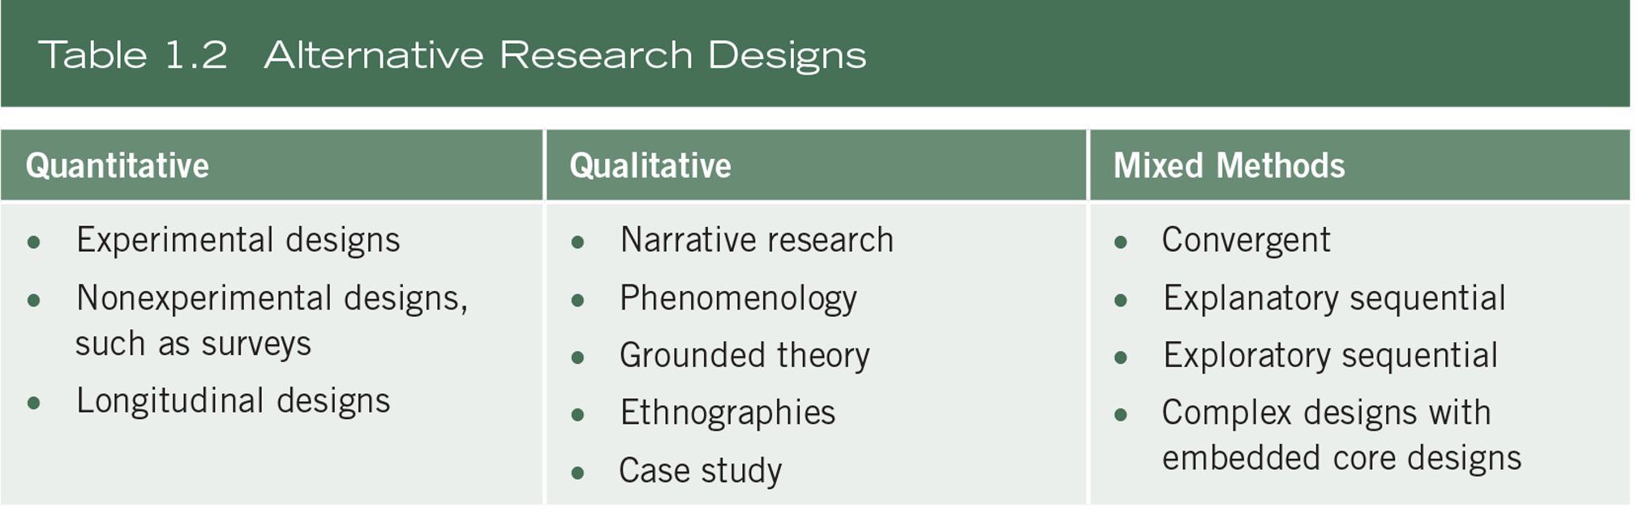
Three Components Involved in an Approach

Slide 13
Three Components Involved in an Approach
Quantitative research designs:
Causal-comparative research
Correlational design
Survey research
Experimental research

Slide 14
Three Components Involved in an Approach
Qualitative research designs:
Narrative research
Phenomenological research
Grounded theory
Ethnography
Case studies

Slide 15
Three Components Involved in an Approach
Mixed methods research designs:
Integration of quantitative and qualitative research and data and analyses
Core designs
  Convergent parallel mixed methods
  Explanatory sequential mixed methods
  Exploratory sequential mixed methods
Complex designs (e.g., experiment)

Slide 16
Three Components Involved in an Approach
Research methods:
Specific forms of
  Data collection (e.g., instrument, observations)
  Analysis (e.g., statistical analysis, interpret themes)
  Interpretation

Slide 17
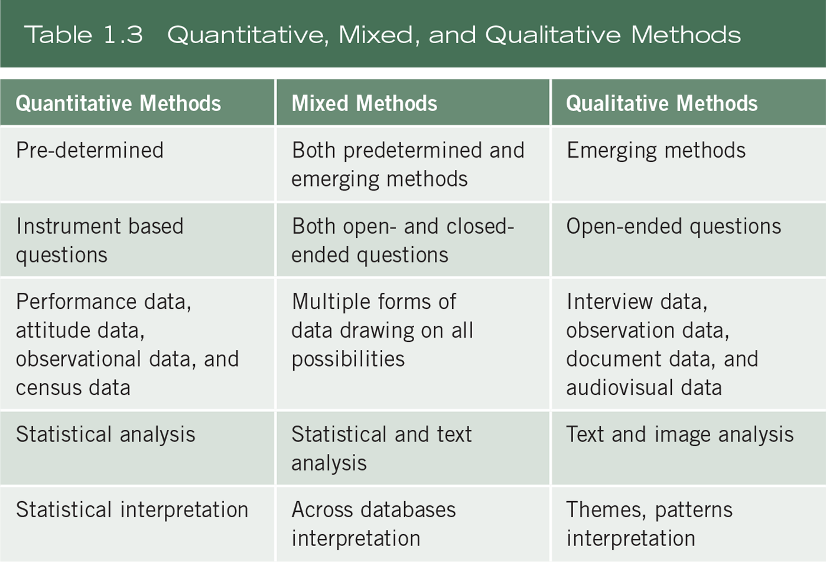
Three Components Involved in an Approach

Slide 18
Research Approaches as Worldviews, Design, and Methods
Research approach tends to be quantitative, qualitative, or mixed methods
Compare philosophy, strategies, methods

Slide 19
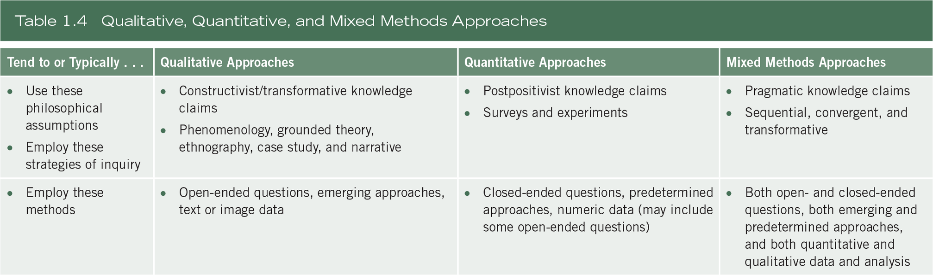
Research Approaches as Worldviews, Design, and Methods

Slide 20
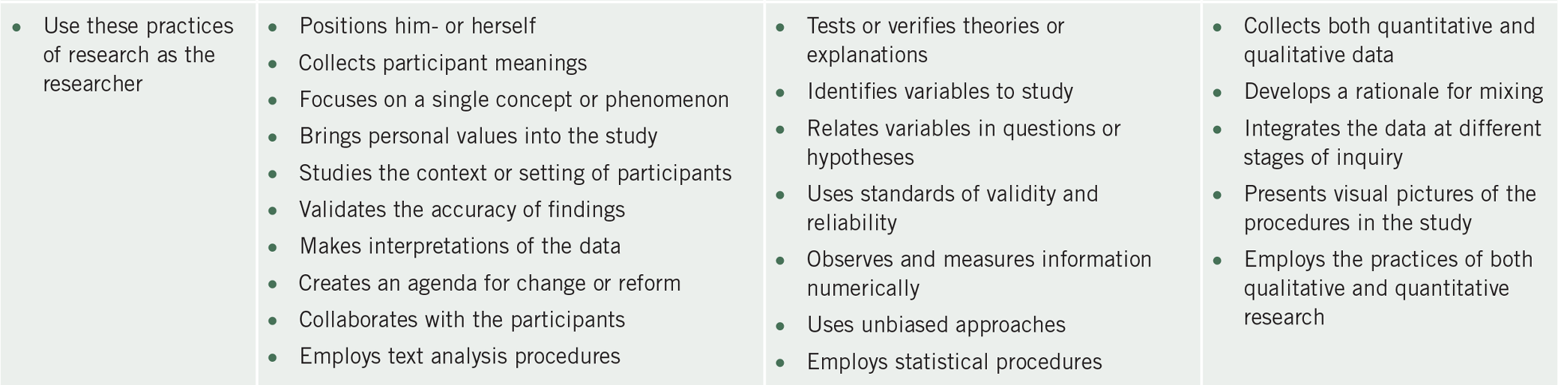
Research Approaches as Worldviews, Design, and Methods

Slide 21
Research Approaches as Worldviews, Design, and Methods
Quantitative approach scenario:
  Postpositivist worldview
  Experimental design
  Pretest and posttest measures of attitudes

Slide 22
Research Approaches as Worldviews, Design, and Methods
Qualitative approach scenario:
  Constructivist worldview
  Ethnographic design
  Observation of behavior

Slide 23
Research Approaches as Worldviews, Design, and Methods
Qualitative approach scenario:
  Transformative worldview
  Narrative design
  Open-ended interviewing

Slide 24
Research Approaches as Worldviews, Design, and Methods
Mixed methods approach scenario:
  Pragmatic worldview
  Collection of both quantitative and qualitative data sequentially in the design

Slide 25
Criteria for Selecting a Research Approach
The research problem and questions:
Quantitative approach is best when
  Identifying factors that influence a particular outcome
  Evaluating the utility of an intervention
  Understanding best predictors of an outcome
Notes:
Chapter 5 power point provides more details on this topic

Slide 26
Criteria for Selecting a Research Approach
The research problem and questions:
Qualitative approach is best when
  The topic is new
  The subject has not been addressed with a certain sample
  Existing theories do not apply
Notes:
Chapter 5 power point provides more details on this topic

Slide 27
Criteria for Selecting a Research Approach
  The research problem and questions:
Mixed methods approach is best when:
  Neither quantitative nor qualitative approaches are adequate to understand a research problem
  The strength of qualitative and quantitative approaches provides the best understanding
  E.g., generalize findings and develop detailed view

Slide 28
Criteria for Selecting a Research Approach
  Personal experiences:
Training
Preferences
Time
Resources
Experiences

Slide 29
Criteria for Selecting a Research Approach
Audience:
Journal editors
Journal readers
Faculty committees
Conference attendees
Colleagues in the field
Advisers

Slide 30
Summary
Identify approach as qualitative, quantitative, or mixed methods
Approach includes worldview, research design, and research methods
Choice of approach
  Research problem
  Personal experiences
  Audience

